Slide 1
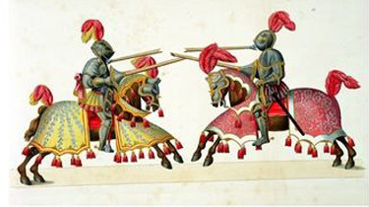
Knights

Slide 2
The medieval era was a time of constant warfare. Lords and their armies fought one another within their own countries; they fought for their kings in battle against other countries; and sometimes they joined forces to try and replace their king with a new monarch.
The most significant person on the battlefield was the knight in his armour.

Slide 3
Knights were warriors on horseback, who fought for their king, their lord or, in some cases, for whoever would pay for their services.
The early knights could be `lowly born' men, who were rewarded for bravery and skill in battle.
By the thirteenth century, only men of noble birth were admitted to the knighthood and, even then, only after years of training in military skills, service to others and Christian teachings.

Slide 4
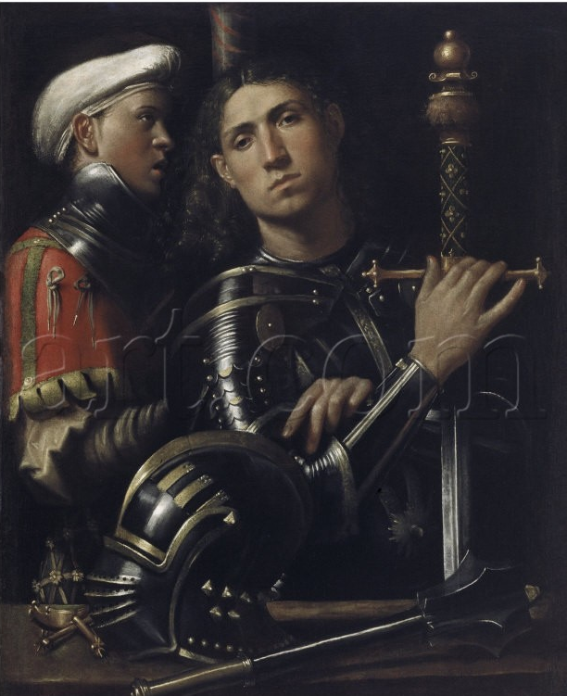
Page
Training for knighthood began at the age of seven when a young boy left his own family to learn the skills of a page at a nearby castle.
A page learned to be polite, to serve God, to ride and hunt for wild game, to understand the role of the knight, chivalry and loyalty to his liege lord, and sometimes to read and write.

Slide 5
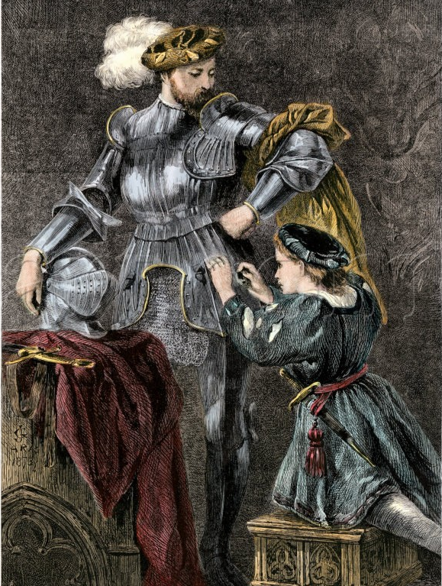
Squire
If the page showed promise, then at fourteen years of age he could become a squire.
Through service to a knight, he would learn to look after the knight’s armour, weaponry and horses and continue training in military skills, social graces and cultural pursuits.
While he was a squire, he was allowed to carry a sword and a shield, which showed what rank he had achieved.

Slide 6
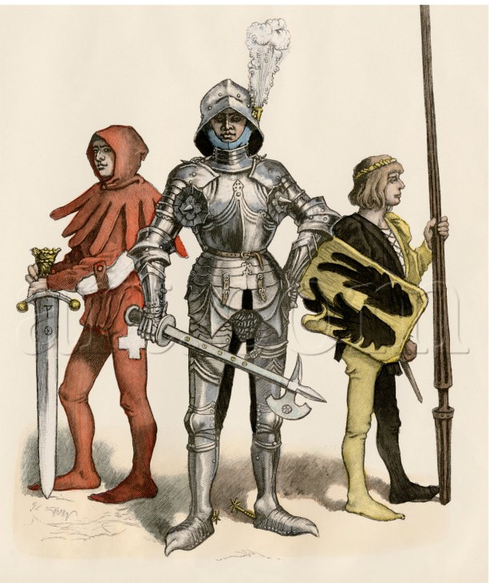
Knight
By the age of about 21, the young man was eligible for knighthood and expected to live his life according to the rules known as the code of chivalry.

Slide 7
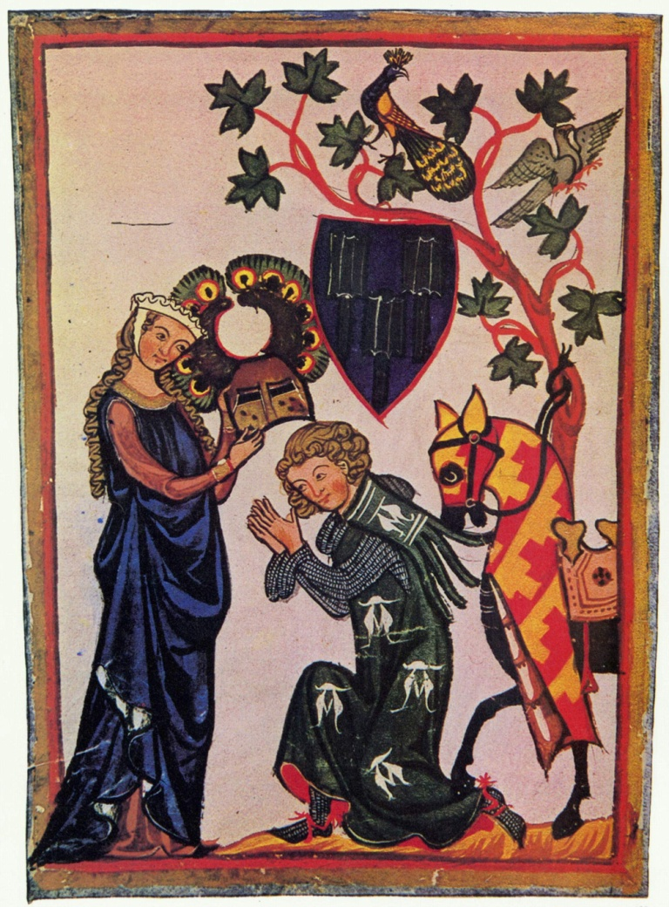
Code of Chivalry
The chivalrous knight was:
loyal to the Catholic Church
dedicated to helping those who were weak and easily exploited
brave in battle
willing to fight to protect women

Slide 8
At The Tournament
When not in battle, knights practised their skills. They did this individually in exercises called `tilting the quintain' or in organised tournaments.
Tournaments developed from the custom of teams of knights jousting or competing against one another on a local field. These often violent events were called mêlées.
Over time, people began to develop strict rules and greater organisation for this type of activity and to call its new form `tournaments'. Tournaments attracted large audiences that enjoyed the excitement of seeing who would be the hero of the day.

Slide 9

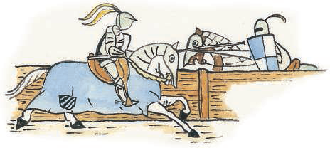
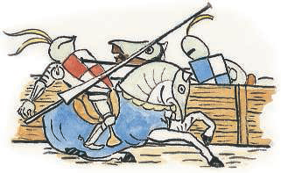

Slide 10
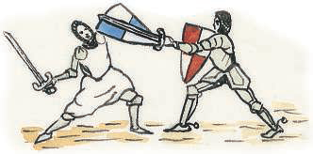
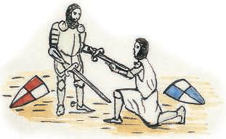

Slide 11

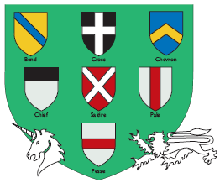
Table showing the metals and colours used in heraldry.
Examples of heraldic designs (charges) and symbols (devices).

Slide 12
Make your own shield!!

